Slide 1
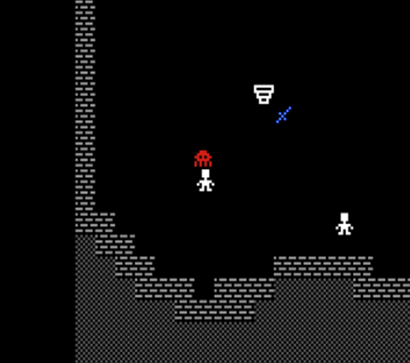
Dungeon of the Rogue Daemon
Leif Bloomquist
Roguelike Celebration
2020
Online!
October 3-4 2020

Slide 2
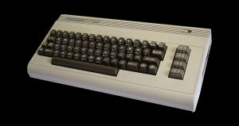

Why the Commodore 64?
Best-selling computer of all time! (Guinness Book of World Records: ~17 Million sold)
Over 25,000 games for the platform, including many Roguelikes
Fun to program on: Bare-metal, machine language, very well documented
Very active community in 2020: Gaming, collecting, developing, hardware hacking…
New networking hardware opens so many doors for multiplay
Photo Credits: VintageVibe, Wikipedia

Slide 3
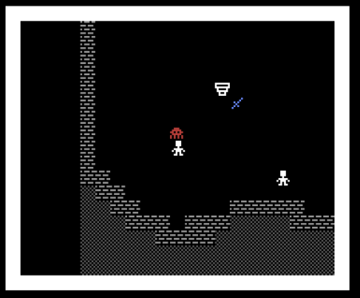
Next Challenge: A Roguelike
What if…the other characters in the dungeon were other players that you could…
Interact with?
Go on quests together with?
Team up with against monsters?
Work together with to solve puzzles?
Leave each other tools, clues, share equipment?
That would be cool!

Slide 4
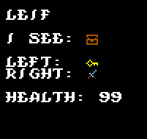
Unique? Gameplay Mechanics
Carry items in Left hand and/or Right hand
Double up swords or shields, or one of each
Other items to be carried: Potions, Keys, Gold, etc
No “inventory” (to encourage multiplayer)
Use or inspect items

Slide 5
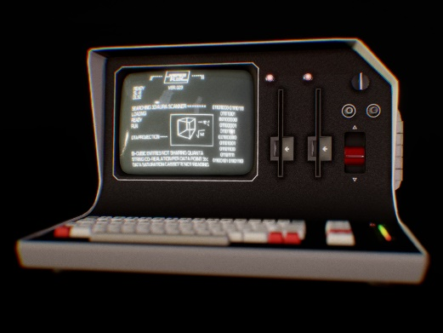
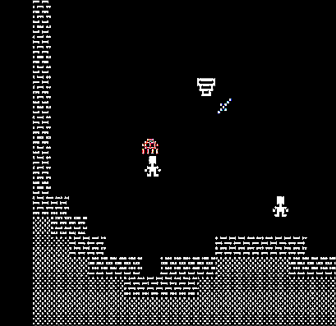
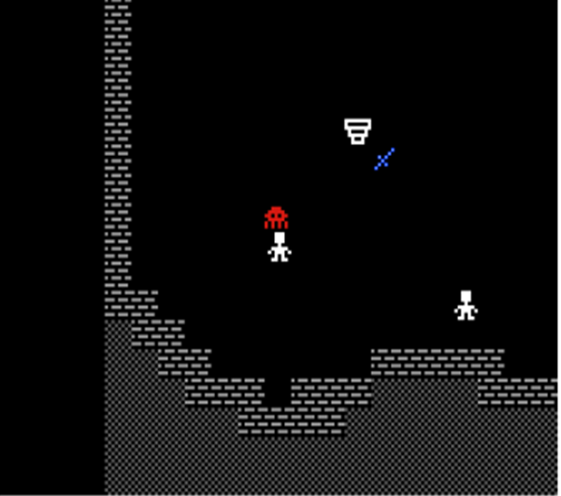
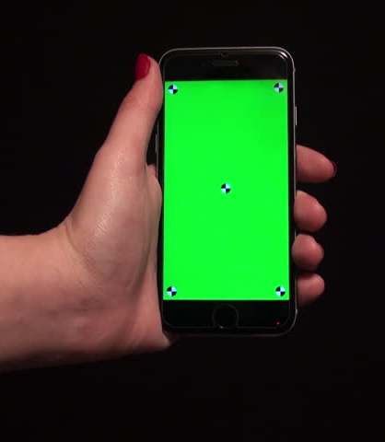

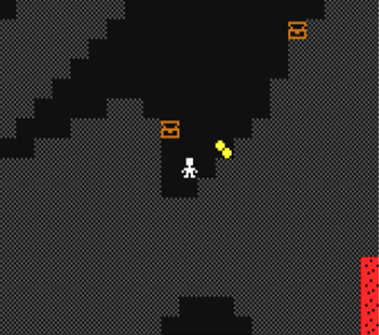
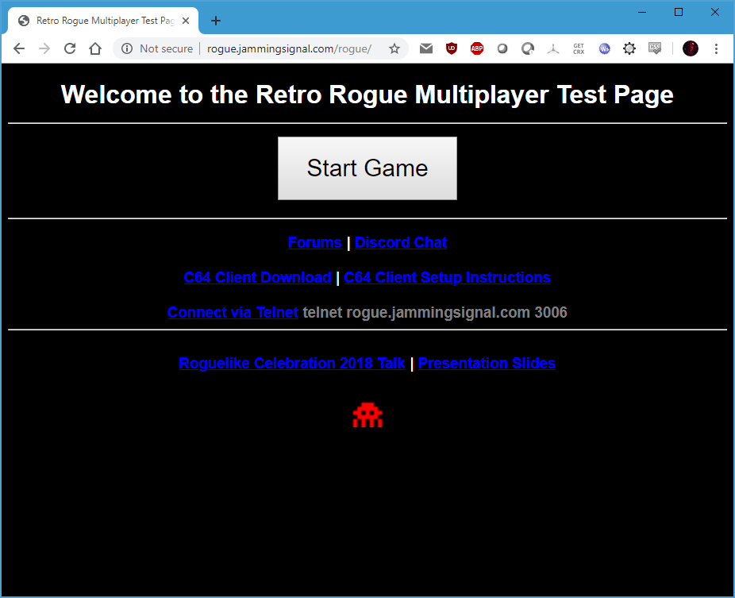
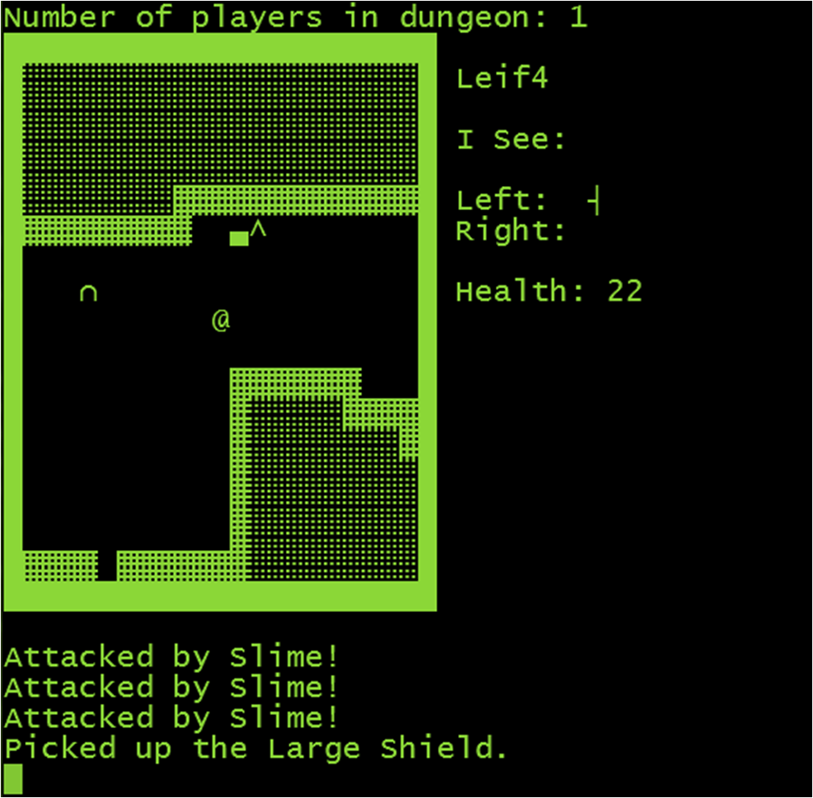
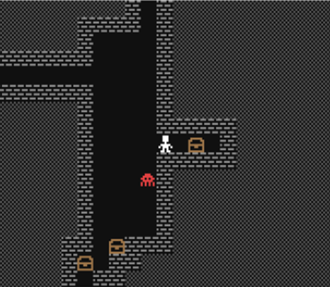
Many Platforms, All Playing Together!
Other Retro Platforms
Commodore 64
Dungeon
Mobile
Telnet / VT100
Modern Web Browser

Slide 6
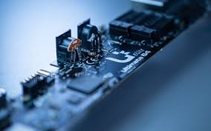

What’s New since 2019?
The Game has a Name!
Choose an avatar for your character
Many new Items and Monsters
Support for the new “Ultimate 64” – Commodore 64 on an FPGA
Mobile version (not perfect yet…)

Slide 7
// TODO
Improved mobile interface
Ranged weapons
Improve monster AI
Much larger dungeon – procedurally generated

Slide 8




Contact Info
www.jammingsignal.com (blog)
www.facebook.com/LeifBloomquist
@schemafactor
leif@schemafactor.com

Slide 9
Thank You!
C64 Networking code: Per Olofsson, Jonno Downes, Scott Hutter
Playtesting: Andreas Bloomquist and Mark Seelye
Graphics: “q0w/Atlantis”
Advice and motivation: Robin Harbron
/r/roguelikedev community on Reddit
The organizers of Roguelike Celebration!

Slide 10

Enough Talking, Let’s Play!
Web: http://rogue.jammingsignal.com/rogue/
Telnet: rogue.jammingsignal.com port 3006
The game is winnable: What is the magic word?

